Slide 1
Programming Fundamentals
Lecture 25

Slide 2
Objectives
Pointers to Objects
Polymorphism
Virtual Functions
Pure Virtual Function
Abstract Base Class
Composition
Aggregation

Slide 3
Pointers to Objects
Just like pointers to other data types (int, float, char etc) we can declare pointers to objects
The syntax for pointer to an object is
class_name *pointer_name;
For example, we have defined a class named Date and we want to declare a pointer to the object of Date class
Date *dptr;

Slide 4
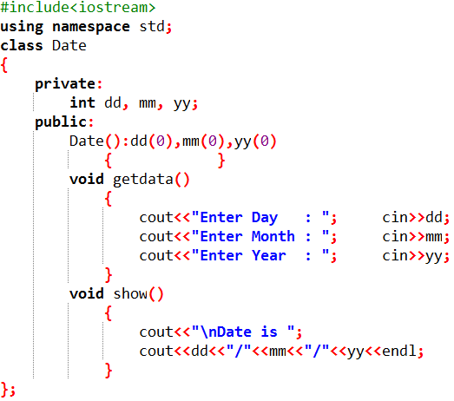
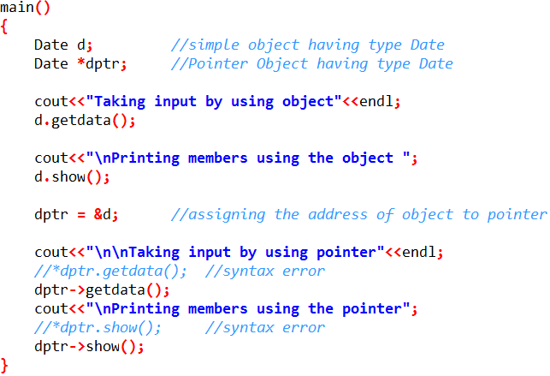
Pointers to Objects (Example)
Lets define a class named Date to input and display the date by using pointers
File with the name “Pointer_to_Object” is available on slate

Slide 5
Polymorphism
The word polymorphism means having many forms
In simple words, we can define polymorphism as the ability of a message to be displayed in more than one form
Real life example of polymorphism is a person
  At the same time can have different characteristic. Like a man at the same time is a father, a husband, an employee
So the same person posses different behavior in different situations. This is called polymorphism
Polymorphism is considered as one of the important features of Object Oriented Programming
  It is so important that the languages which don’t support polymorphism cannot advertise them as Object Oriented (OO) languages
  The languages which support classes but not polymorphism are called “Object Based” languages

Slide 6
Types of Polymorphism
Polymorphism
Compile Time Polymorphism
OR
Early Binding
Runtime Polymorphism
OR
Late Binding
Function Overriding
(when base class pointer is used to access derived class)
Function/Operator
Overloading
Virtual
Functions

Slide 7
Compile Time Polymorphism
Function Overloading
  Two or more functions in the same scope with same identifier but with different parameters (either number of parameters are different or type of parameters are different)
Operator Overloading
  Two or more same operators in the same scope with different meanings
Function Overriding (when a base class pointer is used to access derived class)
  Functions with the same identifier and same parameters in base and derived class(es)
All three concepts are already discussed in detail

Slide 8
Example 1
Before explaining the runtime polymorphism lets have a look at the given example
Suppose that we have a base class with a function show() and we have a derived class having the function with the name show()
Now in main program we create a pointer to Base class object and through Base class pointer we access the object of derived class
Have a look at the file named “Polymorphism”

Slide 9
Analysis of Example 1
An Object (either Normal or Pointer) of derived class is type compatible with pointer to base class.
So, ptr = &d; is allowed in previous example
But the results of our program are incorrect
  The reason for the incorrect output is that the call of the function show() is being set once by the compiler as the version defined in the base class
  This is called static resolution of the function call, or static linkage - the function call is fixed before the program is executed
  This is also sometimes called early binding because the show() function is set during the compilation of the program

Slide 10
Logical Error Removal in Example 1
In order to get the correct output from example1 we need to declare the show() function in base class as a virtual function
Virtual Function
  A virtual function is a function in a base class that is declared using the keyword virtual before its return type
  Defining in a base class a virtual function, with another version in a derived class, signals to the compiler that we don't want static linkage for this function
  What we do want is the selection of the function to be called at any given point in the program to be based on the kind of object for which it is called. This sort of operation is referred to as dynamic linkage, or late binding

Slide 11
Runtime Polymorphism
Runtime polymorphism is also known as dynamic polymorphism or late binding
In runtime polymorphism, the function call is resolved at run time
In contrast, to compile time or static polymorphism, the compiler deduces the object at run time and then decides which function call to bind to the object
The runtime polymorphism is achieved with the help of virtual functions

Slide 12
Runtime Polymorphism (Example)
In example 1 if we replace the
  void show()
  { }
With
  virtual void show()
  { }
Then show method will become virtual in base class
And in main program, the compiler looks at the contents of the pointer instead of it's type
Hence, since address of object of Derived class is stored in *Base the respective show() function is called

Slide 13
Pure Virtual Function
It is possible that we want to include a virtual function in a base class so that it may be redefined in a derived class to suit the objects of that class, but that there is no meaningful definition we could give for the function in the base class
We can change the virtual function show() in the base class to the following
virtual void show() = 0;
The = 0 tells the compiler that the function has no body and above virtual function will be called pure virtual function

Slide 14
Abstract Base Class
Sometimes implementation of all functions cannot be provided in a base class because we don’t know the implementation
Such a class is called abstract class
  For example, let Shape be a base class. We cannot provide implementation of function calculate_area() in Shape, but we know every derived class must have implementation of calculate_area()
Any class having at least one pure virtual function will act as an abstract base class
We cannot create objects of abstract base class
Have a look at the file named “abstract_base_class”

Slide 15
Some Facts about Abstract Base Class
A class is abstract if it has at least one pure virtual function
  See the file named “Abstract_class_fact_1”
We can have pointers and references of abstract class type
  See the file named “Abstract_class_fact_2”
If we do not override the pure virtual function in derived class, then derived class also becomes abstract class
  See the file named “Abstract_class_fact_3”
An abstract class can have constructors
  See the file named “Abstract_class_fact_4”

Slide 16
Practice Problem 1
Write a C++ program to compute and display the area of a rectangle, triangle, square and circle using an abstract base class named shape. The Shape class has one data member area and three functions to take the input, compute and display the area.
Make the area and input function as pure virtual function and show function a virtual function
In main program declare a pointer to type Shape and access all the other derived classes objects by using the pointer of base class
Solution is attached with the file name “Lecture_25_PP1”

Slide 17
Relating the Classes
Classes can create new classes from existing classes
This important feature encourages code reuse
In C++, you can relate two or more classes in more than one way
Two common ways to relate classes in a meaningful way are:
  Inheritance (‘‘is-a’’ relationship)
  Composition/Aggregation (‘‘has-a’’ relationship)

Slide 18
Inheritance vs Composition/Aggregation
Inheritance
  Inheritance lets us create new classes from existing classes
  The new classes that we create from the existing classes are called the derived classes; the existing classes are called the base classes
Composition/Aggregation
  When a class contains object(s) of other class(es) as data members then this sort of relation is called composition/aggregation

Slide 19
Where to Use Inheritance?
In object-oriented programming, we can use inheritance when we know there is an "is a" relationship between a derived and its base class, some examples would be:
  An employee is a person
    Person→Base, Employee →Derived
  A cat is an animal
    Animal→Base, Cat →Derived
  A car is a vehicle
    Vehicle→Base, Car→Derived
  A rectangle is a shape
    Shape→Base, Rectangle→Derived
  In each case, the derived or subclass is a specialized version of the base or superclass

Slide 20
Where to Use Composition/Aggregation?
In object-oriented programming, we can use composition/aggregation in cases where one object "has" (or is part of) another object some examples would be:
  A car has a wheel
    An object of Wheel class will be a data member of Car class
  A person has a heart
    An object of Heart class will be a data member of Person class
  A house has a room
    An object of Room class will be a data member of House class
  An employee has a date of birth
    An object of Date class will be a member of Employee class
  In each case both the classes are not specialized versions of each others

Slide 21
Composition in C++ (Example)
An employee has a date of birth and date of joining along with his/her name, salary and work hours.
So here we will add two objects of Date class as data members in Employee class
See the file named “Composition”

Slide 22
Difference Between Composition and Aggregation
Aggregation
Composition
A relationship where the child can exist independently of the parent
  Example: Class (parent) and Student (child)
  Delete the Class and the Students still exist
Parts can belong to more than one object at a time
Parent class contains the address of an object of child class
A relationship where the child cannot exist independent of the parent.
  Example: House (parent) and Room (child)
  Rooms don't exist separate to a House
Parts can belong to only one object at a time
Parent class contains the object of child class

Slide 23
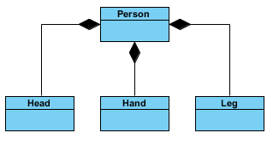
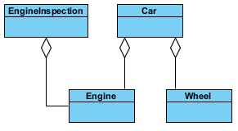
Composition and Aggregation in UML Class Diagrams
Composition
Head, Hand and Leg cannot exist without a Person
A specific head can belong to only one person
Aggregation
Wheel and Engine can exist without car
An engine can belong to a car and engine inspection class

Slide 24
Aggregation Example
Every Student may have an address and more than one students can have the same address
Students may come and go, but the address will remain there
So here we will use the concept of aggregation instead of composition
See the file named “Aggregation”

Slide 25
Practice Problem 2
Modify the code of “Composition” to add the following features
Include some checks in overloaded constructor to validate the day and month
Include some functions to ask the user to enter the details of an employee including date of joining and date of birth
Change the main program to test your code

